Slide 1
Catalyst (5 minutes)
From what you may already know, what are some tools we use to measure weather?
From hearing weather broadcasts on the TV and radio, what are some weather terms used to describe or predict weather?
From our first week of the Weather unit, in what layer does weather occur?

Slide 2
Make-up quizzes in Science
6-03,6-04, 6-05
TUESDAY ENRICHMENT
6-01, 6-02
THURSDAY ENRICHMENT
Jeremiah (18)
Denise (18)
Tanzania (18)
Brianna (18)
Mya (18)
Ben (19)
Sam (19)
Travius (19)
Nickolas (19)
Rikyah (19)
Kiahnna (19)
Lloyd (18)
Carlton (18)
Wayne (18)
Sheredith (18)
Olivia (19)
Shane (19)
Lloyd (19)
Kimeidra (19)
Emily (19)
Anber (19)
Elijah (19)
Mariah (19)
Wayne (19)
Sheredith (19)
Elizabeth (19)

Slide 3
Put together last week’s catalyst for collection!
Cornell Notes from last Tuesday: Classwork section of your binder.
Homework from last Tuesday Night: Homework Section of your binder!
Make sure your papers are organized by date!
Nothing should be in the pockets of your folder or binder!
Add your four notecards from last week to your vocab ring (you now have 114!!!)

Slide 4
Cornell Notes
Today’s Cornell Notes will focus on two sections in Chapter 7 – Section 1 and Section 4
This week we will be learning about terms and tools used to measure and predict weather!

Slide 5
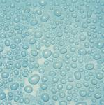
Humidity
The amount of water vapor in the air.
As the temperature in the air increases, the ability to hold water vapor also increases!

Slide 6
Relative Humidity
The amount of water vapor in the air compared with the maximum amount of water vapor that the air can hold at a certain temperature.
When air holds all of the water that it can at a given temperature, it is said to be saturated.
Saturated air has a relative humidity of 100%

Slide 7
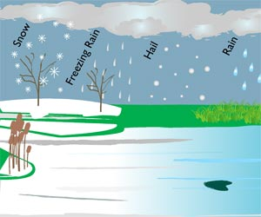
Precipitation
Water, in solid or liquid form, that falls from the air to Earth.
There are four major forms of precipitation – rain, snow, sleet, and hail.

Slide 8
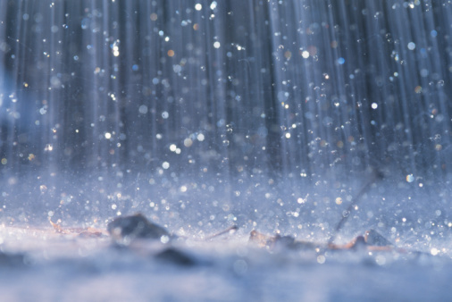
Rain
A cloud produces rain when the water drops in the cloud become a certain size.
A water drop in a cloud begins as a droplet, and must become about 100 times bigger to be considered rain!

Slide 9
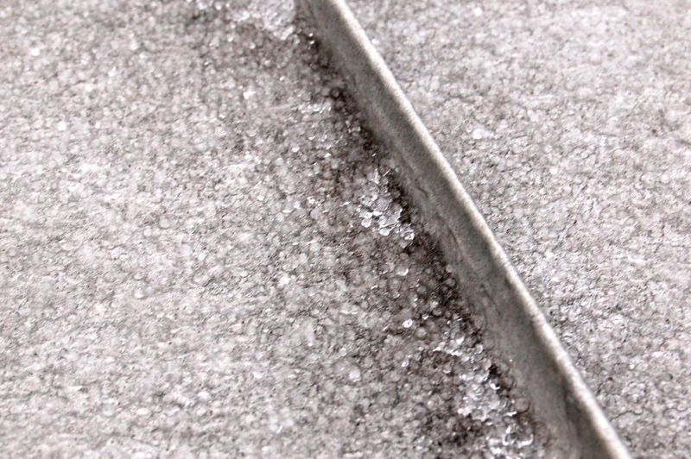
Sleet
When rain falls through a layer of freezing air.
The rain freezes in the air, which produces falling ice.

Slide 10
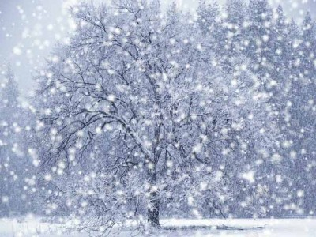
Snow
When temperatures are so cold that water vapor changes directly to a solid.
Snow can fall as ice crystals or can join to form snowflakes.

Slide 11
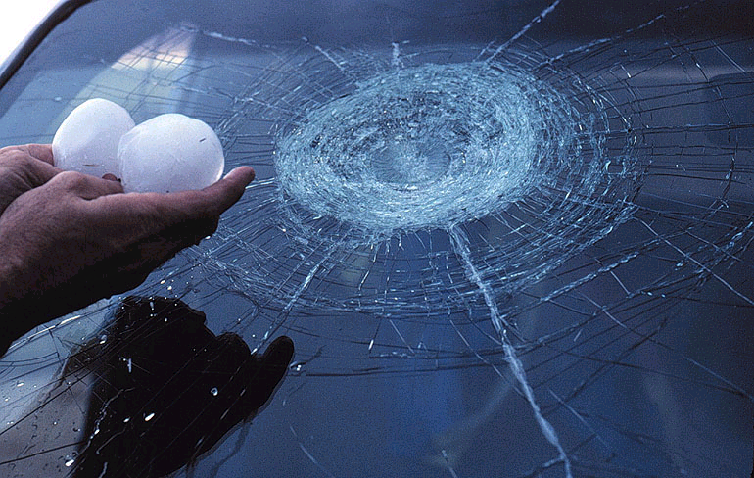
Hail
Balls or lumps of ice that fall from clouds.

Slide 12
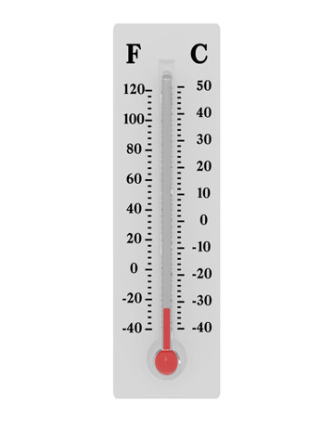
Thermometer
A tool used to measure air temperature.
When air temperature increases, the liquid expands and moves up the glass tube.
When air temperature decreases, the liquid shrinks and moves down the tube.

Slide 13
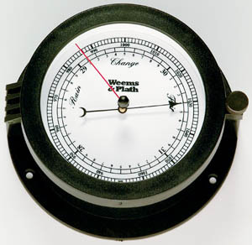
Barometer
An instrument used to measure air pressure.
The greater the air pressure is, the higher the mercury will rise.

Slide 14
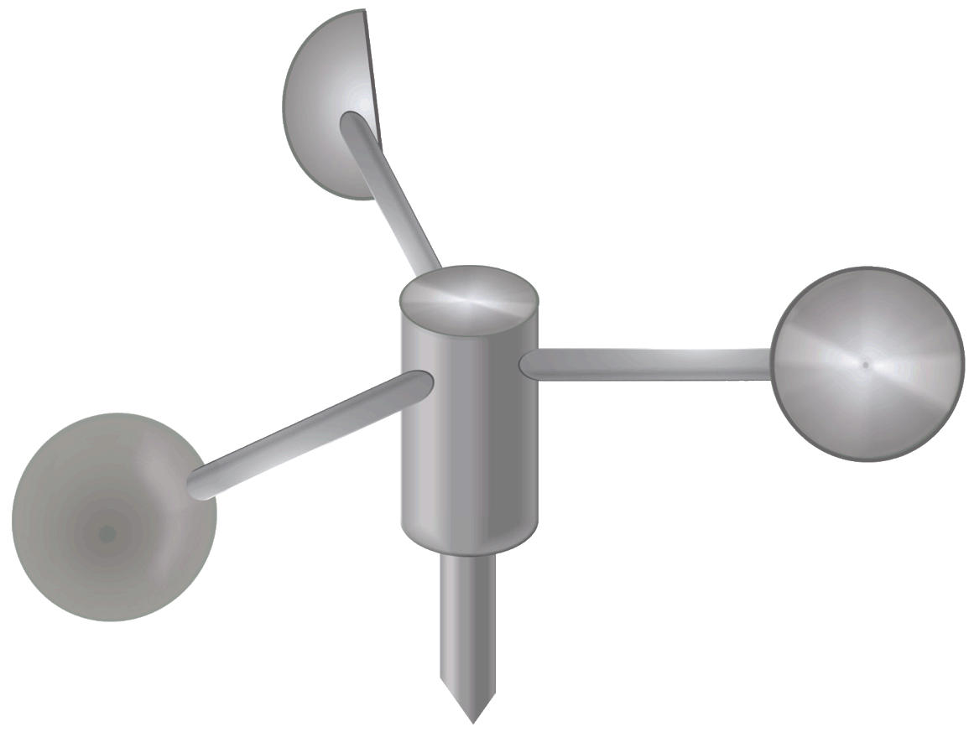
Anemometer
An instrument used to measure wind speed.

Slide 15
Whiteboard Practice

Slide 16
What is the term used for water that falls from the air to Earth? (it can be solid or liquid form)

Slide 17
Precipitation
Water, in solid or liquid form, that falls from the air to Earth.
There are four major forms of precipitation – rain, snow, sleet, and hail.

Slide 18
What weather tool is used to measure wind speed?

Slide 19
Anemometer
An instrument used to measure wind speed.

Slide 20
What is the term used to describe the amount of water vapor in the air?

Slide 21
Humidity
The amount of water vapor in the air.
As the temperature in the air increases, the ability to hold water vapor also increases!

Slide 22
When rain falls through a layer of freezing air, it falls as ice.

Slide 23
Sleet
When rain falls through a layer of freezing air.
The rain freezes in the air, which produces falling ice.

Slide 24
This form of precipitation occurs when it is so cold that water vapor turns directly into a solid.

Slide 25
Snow
When temperatures are so cold that water vapor changes directly to a solid.
Snow can fall as ice crystals or can join to form snowflakes.

Slide 26
Homework Tonight
Read “Predicting the Weather” lesson
Answer the discussion question using complete sentences.
Answer the four lesson review questions
KEEP WORKING ON:
Study Island (Island Friday Packet)
Your vocab ring (114 terms)

