Slide 1
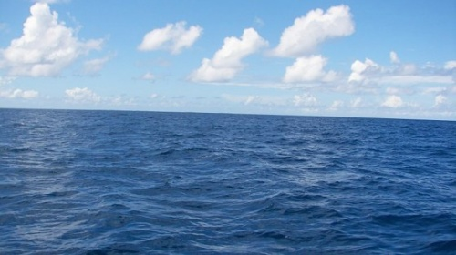
Catalyst (5 minutes)
What kinds of actions/behaviors led you to your quiz score yesterday?
From what we learned last week, what does warm air do? What does cold air do?
When the Sun heats the air to cause the circular motion of warm air and cool air, what do we call this?

Slide 2
Doing your Homework really does help you!
Here is an example of a scholar who worked hard last week and got smart!
One scholar did all of their homework last week and scored a perfect 100% on yesterday’s quiz.
2 weeks ago, when that scholar didn’t turn in one of their homework assignments, they scored a 55%.
You aren’t born smart,
You work hard to GET SMART!

Slide 3
Not working hard really doesn’t help you ….
Last grading period, this scholar averaged 90% on all of their assessments (both unit tests and weekly quizzes).
Last week, this scholar did not complete their reading homework and their notecards, and scored a 60% on yesterday’s quiz.
You aren’t born smart,
You work hard to GET SMART!

Slide 4
Cornell Notes: Currents
Today, we are going to learn how Earth’s waters can move like Earth’s air does
Turn your books to page 125.
We will be focusing this week on Chapter 5, Sections 1 & 2 – so this will be an important resource to study.
After we get our notes, we will work with a partner to understand what we just read.

Slide 5
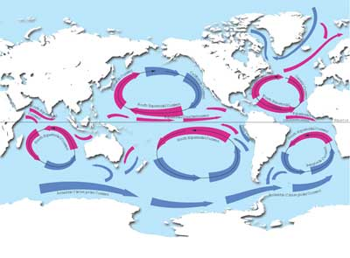
Ocean Currents
Streamlike movements of water.

Slide 6
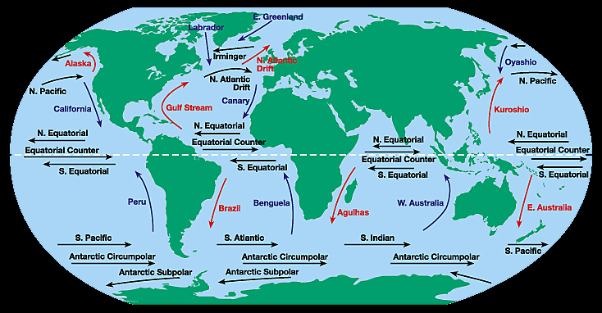
Surface Currents
Streamlike movements of water that occur at or near the surface of the ocean.

Slide 7
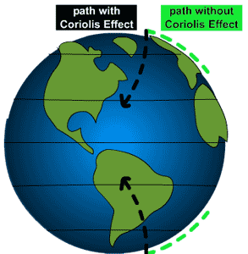
The Coriolis Effect
The Earth’s rotation causes wind and surface currents to move in curved paths rather than in straight lines.

Slide 8
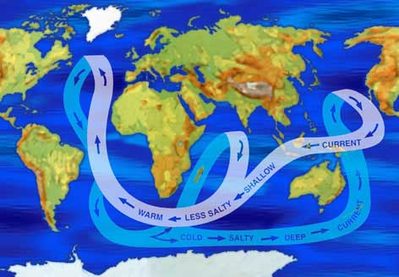
Deep Currents
Streamlike movements of ocean water far below the surface.

Slide 9
Understanding the causes of currents: Working with a Partner
Using the chapter section we just read about, answer the following questions on your Cornell Notes with a partner
List the three factors that cause surface currents.
List the three factors that cause deep currents.
How are surface currents and deep currents different?

Slide 10
3 factors that cause Surface Currents
(1) Global winds
(2) The Coriolis Effect
(3) Continental deflections
These three factors keep surface currents flowing in distinct patterns around the Earth.

Slide 11
3 factors that cause Deep Currents
(1) Decreasing temperature
(2) Increasing salinity through freezing
(3) Increasing salinity through evaporation

Slide 12
Homework tonight
Make sure you are reading more about ocean currents tonight!
After reading, answer the discussion question using complete sentences.
Then, answer the four lesson review questions.
Make four notecards for your four terms!
(Ocean current, Surface Current, Coriolis Effect, Deep Current)

