Slide 1
Catalyst (5 minutes)
Correctly list the layers of the atmosphere from the lowermost layer to the outermost layer.
Match the following definitions to the terms we learned on Wednesday (radiation, thermal conduction, convection).
Circular movement of air that is responsible for our winds (i.e. sea breezes and land breezes)
When air molecules come into direct contact with warm land, the heat from the land is transferred to heat the air.
This heat transfer is responsible for the Sun’s thermal energy reaching the Earth's surface.
What kind of breeze is likely to occur near the sea during the night? Why is this?

Slide 2
This Week’s Schedule
Monday, 2/14 Weekly Quiz | Solar Energy & the Atmosphere Weekly Quiz 18
Tuesday, 2/15 * Homework tonight | - Cornell Notes: Ocean Currents
Wednesday, 2/16 * Homework tonight | - Reading homework due - Ocean Currents of the World
Thursday, 2/17 * Study tonight!! | - Group practice of ocean currents
Friday, 2/18 Weekly Quiz | Wednesday night homework due Weekly Quiz 19: Ocean Currents

Slide 3
Put together last week’s catalysts for collection! (6-01 & 6-02, you have Tuesday & today’s)
Homework from Monday & Wednesday Night: Homework Section of your binder!
Cornell Notes: Classwork Section of your binder
Make sure your papers are organized by date!
Nothing should be in the pockets of your folder or binder!
Add 8 notecards behind the yellow Weather notecard- you now have 109!!!

Slide 4
Order the Atmosphere’s Layers!
If you sit by someone in your row, you make work with them quietly.
Take the paperclip off your stack.
Find “Earth’s Surface” and place it at the bottom of your desk
Then find “Outer Space” and place it at the top of your desk.
Order the layers of the atmosphere, from the closest to the Earth’s surface, to the closest to outer space.
Then, match the definitions of the layers with the layers you have ordered!
When you are finished, put the Earth’s surface at the top and Outer Space at the bottom and reorder them!

Slide 5
Turn over your Online Investigation worksheet
#1
#3
#2
Earth’s Surface

Slide 6
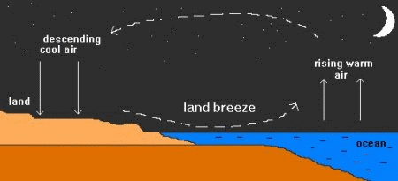
Land Breeze

Slide 7
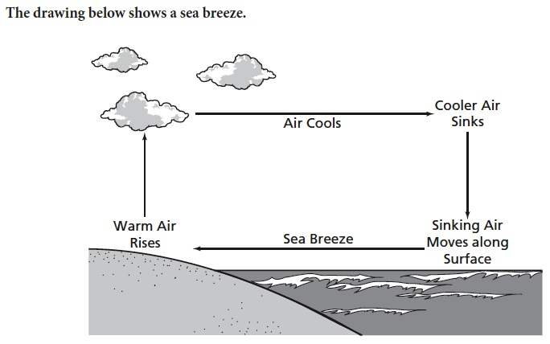
Sea Breeze

Slide 8
Get out your Online Investigation Worksheet, your Island Friday Tracker, your laptop, and a pencil. PUT EVERYTHING ELSE AWAY.

Slide 9
Your Quiz today on Quia
Put away all notes, papers, and note cards
Get out your laptop from its laptop sleeve
Get onto the internet
Type in www.quia.com/web
Search for “McGuirk” in the Teacher Search Box
Click on my profile page
Click on “Weekly Quiz 18: Solar Energy & The Atmosphere”

Slide 10
Weekly Quiz #18 !!!
You will have the remainder of the class period to work on your quiz
THIS ROOM IS TO REMAIN ABSOLUTELY SILENT!
TAKE YOUR TIME, SHOW WHAT YOU KNOW, & GOOD LUCK!
I will distribute new quiz trackers for our Weather Unit on Friday, when we take our next weekly quiz
When you are done with your quiz today, GET CAUGHT UP ON STUDY ISLAND with your Island Friday tracker (Ms. McGuirk will collect them as your ticket out of the door)

