Slide 1
Monday’s Catalyst (5 mins)
What does the word “weather” mean to you?
From the beginning of the year when we learned about the 4 parts of the Earth’s system, what is the Earth’s atmosphere?
Based on what you know about producers and consumers, what kinds of gases do you think we might find in the atmosphere?

Slide 2
Tuesday’s Catalyst (5 mins)
In which layer of the atmosphere does most of our weather occur in? Why is this layer so important?
What three gasses are in the atmosphere?
What is the purpose of the ozone layer?

Slide 3
Brain Pop: The Atmosphere
What is the purpose of the atmosphere?
What is the atmosphere made of?
What are the layers of the atmosphere?

Slide 4
Brain Pop: The Atmosphere
Think about these more detailed questions as you watch the video again today:
What is the gas that makes up most of the atmosphere?
What is in the stratosphere that protects us from harmful rays of the Sun?
What is a part of the thermosphere?
As you watched the video, what three objects did you see floating/flying in the troposphere, stratosphere & exosphere?

Slide 5
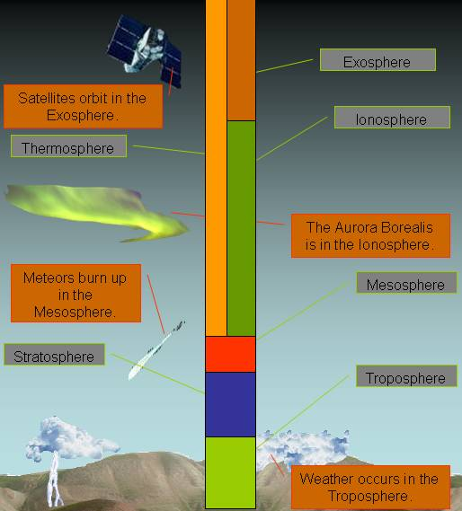
The Layers of the Atmosphere

Slide 6
Definitions
Atmosphere: blanket of gases surrounding Earth
Altitude: height
Temperature: measurement of how quickly or how slowly molecules move around

Slide 7
Makeup of Gases in the Atmosphere
* Most of Earth’s atmosphere is not made up of oxygen. It’s mostly made of nitrogen. This is good because actually, with too much oxygen we would all die. Our insides would start to “rust!”

Slide 8
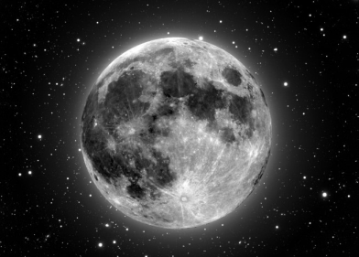
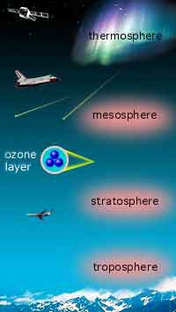
The Five Layers of the Atmosphere
EXOSPHERE

Slide 9
The Troposphere
Lies next to the Earth’s surface
Densest atmospheric level (because gravity pushes down on it the most)
Almost all gases, pollution and life found here
Layer where we live
Layer where weather occurs

Slide 10
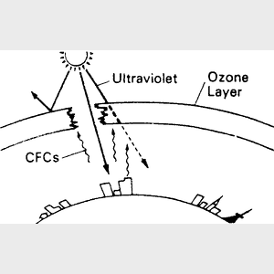
The Stratosphere
Air is very thin
There is almost no moisture in this layer so it’s very dry
* inside the stratosphere
* Contains ozone which absorbs sun rays and keeps us from overheating

Slide 11
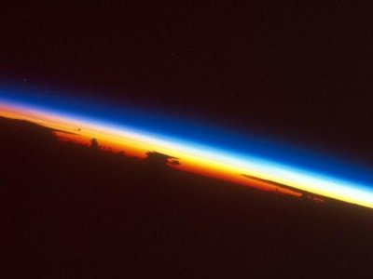
The Mesosphere
Coldest layer
As altitude increases , temperature decreases
Very windy

Slide 12
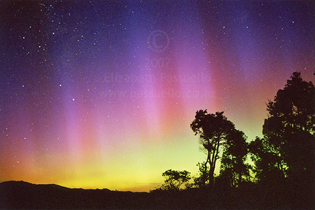
The Thermosphere
*Very high temperature
*This is because the particles are moving fast but do not touch.
* Contains the ionosphere where electricity makes gases light up = The Northern and Southern Lights

Slide 13
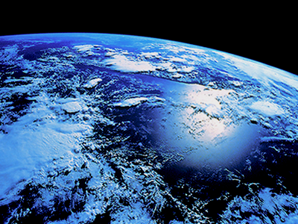
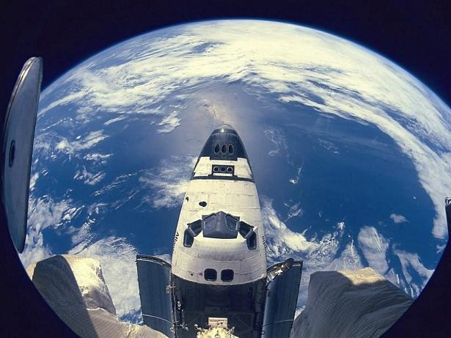
The Exosphere
This is outermost layer, which is closest to space!!

Slide 14
Finishing our Cornell Notes
Today, we will be reading together as a class for pages 156 and pages 157.
It is only 4 paragraphs, so make sure you are following along and asking questions if you don’t understand!
After this, we will be finished with our notes for the week, so stay focused!

Slide 15
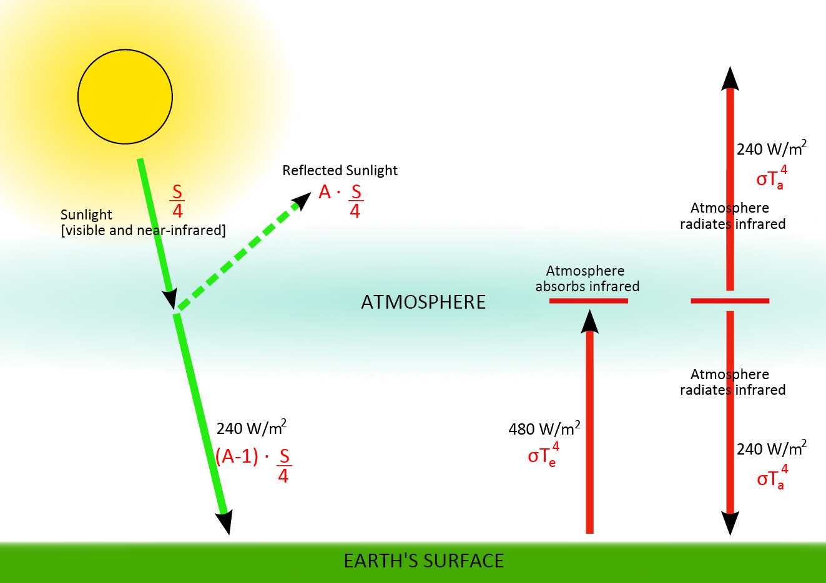
Radiation
The Earth receives energy from the Sun by radiation.
Radiation drives the weather cycle and makes Earth habitable.

Slide 16
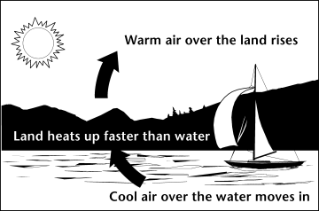
Thermal Conduction
The transfer of thermal energy through a material.
When air molecules come into direct contact with the warm surface of Earth, thermal energy is transferred to the atmosphere.

Slide 17
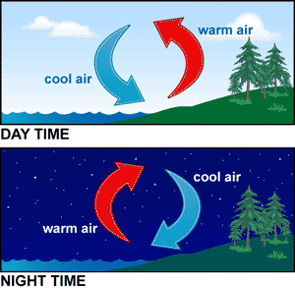
Convection
The transfer of thermal energy by the circulation or movement of a liquid or a gas.
THIS IS THE REASON FOR WINDS!

Slide 18
Whiteboard Practice
Make sure your markers remain capped until a new question appears
You will have 30 seconds to answer each question.
When Ms. McGuirk counts back from 5, you may stand up and show your answer.
Please keep your answer hidden until then!
You may refer to your notes if you need to, but do not look at another scholar’s whiteboard!

Slide 19
What’s the Layer?
The ozone layer is found within this layer.
Because there are layers within this layer, the root term of this atmospheric layer means “layer.”

Slide 20
What’s the Layer?
This is the coldest layer.
The root term of this layer literally means “middle”.

Slide 21
What’s the Layer?
This layer is the outermost layer.
The root term of this layer means “outer”
It is the closest layer to outer space!

Slide 22
What’s the Layer?
This layer is where all weather occurs.
Because of the constant mixing of gasses, the root term literally means “turning” or “changing”
We live in this layer!

Slide 23
What’s the Layer?
This is the hottest layer.
The root term of this atmosphere layer literally means “heat”
The Ionosphere is found within this layer

