Slide 1
Catalyst (5 minutes)
What does the word “weather” mean to you?
From the beginning of the year when we learned about the 4 parts of the Earth’s system, what is the Earth’s atmosphere?
Based on what you know about producers and consumers, what kinds of gases do you think we might find in the atmosphere?

Slide 2
Moon Journal – Phases!
Sun. 1/24 | Mon. 1/25 | Tues. 1/26 | Wed. 1/27 | Thurs. 1/28 | Fri. 1/29 | Sat. 1/30
Sun 1/31 | Mon. 2/1 | Tues. 2/2 | Wed. 2/3 | Thurs. 2/4 | Fri. 2/5 | Sat. 2/6
Sun. 2/7 | Mon. 2/8 | Tues. 2/9 | Wed. 2/10 | Thurs. 2/11 | Fri. 2/12 | Sat. 2/13

Slide 3
Brain Pop: The Atmosphere
What is the purpose of the atmosphere?
What is the atmosphere made of?
What are the layers of the atmosphere?

Slide 4
Cornell Notes: Layers of the Atmosphere
Now that we’ve watched the Brain Pop video about the Atmosphere, we are going to take down some notes about each layer
Using your knowledge from what we just watched, and Chapter 6 Section 1 (pages 150-155), work with a partner to fill in the top half of your Cornell Notes
Make sure you are working only with your partner, and you are not socializing, you only have 10-15 minutes!

Slide 5
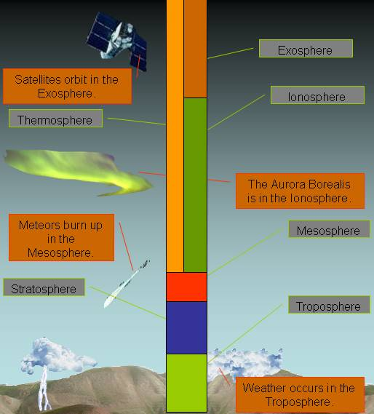
The Layers of the Atmosphere

Slide 6
Definitions
Atmosphere: blanket of gases surrounding Earth
Altitude: height
Temperature: NOT HEAT; measurement of how quickly or how slowly molecules move around

Slide 7
Makeup of Gases in the Atmosphere
* Most of Earth’s atmosphere is not made up of oxygen. It’s mostly made of nitrogen. This is good because actually, with too much oxygen we would all die. Our insides would start to “rust!”

Slide 8
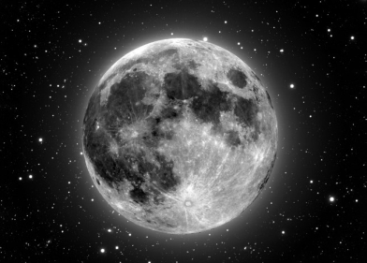
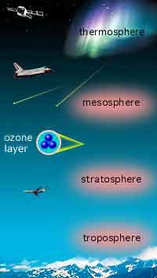
The Five Layers of the Atmosphere
EXOSPHERE

Slide 9
The Troposphere
Lies next to the Earth’s surface
Densest atmospheric level (because gravity pushes down on it the most)
Almost all gases, pollution and life found here
Layer where we live
Layer where weather occurs

Slide 10
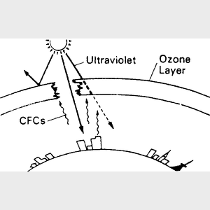
The Stratosphere
Air is very thin
There is almost no moisture in this layer so it’s very dry
* inside the stratosphere
* Contains ozone which absorbs sun rays and keeps us from overheating

Slide 11
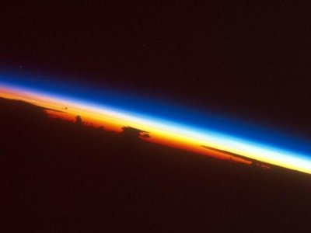
The Mesosphere
Coldest layer
As altitude increases , temperature decreases
Very windy

Slide 12
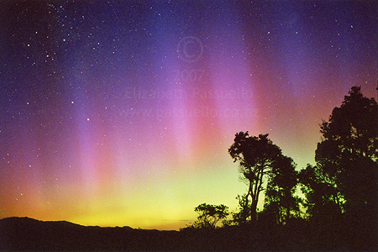
The Thermosphere
*Very high temperature (BUT IT IS NOT HOT).
*This is because the particles are moving fast but do not touch.
* Contains the ionosphere where electricity makes gases light up = The Northern and Southern Lights

Slide 13
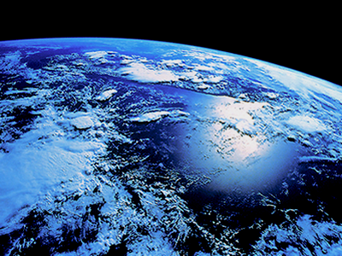
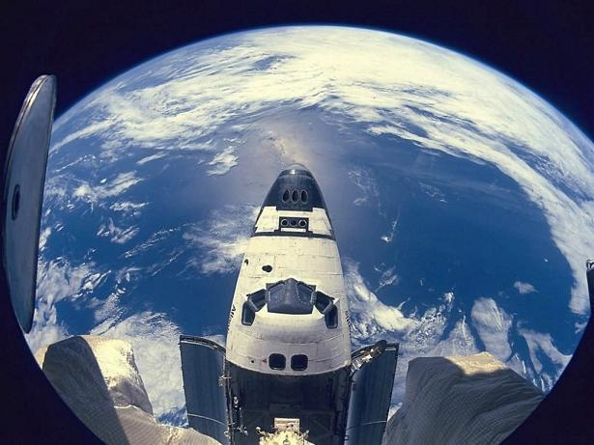
The Exosphere
This is outer space!!

Slide 14
Homework Tonight!
Your homework tonight will be further reading about the atmosphere

