Slide 1
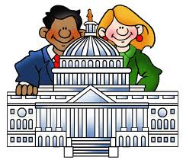
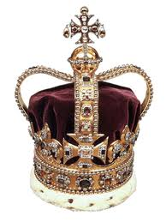
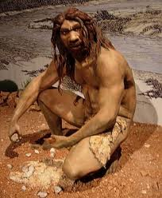
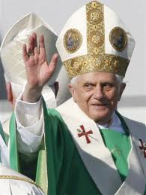
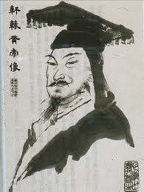
Types of Government
6.4.spi.1 recognize types of government (i.e. formal/informal, monarchy, direct/indirect democracy, republics, theocracy).

Slide 2
Agenda
Reviewing the Question of the Day
What is Government?
Types of Governments
Group Practice with TCAP Questions
Independent Practice

Slide 3
What is Government?
“I hear Ms. Landy say it all the time, but I still don’t really get what it means……..”
This may be you! And it’s OK- we’re going to discuss it NOW!

Slide 4
Government
Government: The leadership in a society.
Please write this down ☺

Slide 5
There are many types of government…
Indirect
Democracy
Informal
Democracy
Republic
Theocracy
Monarchy
Formal

Slide 6
We’re only going to focus on a few…
We are going to focus on the following types of government:
Formal Government
Informal Government
Indirect Democracy
Direct Democracy
Monarchy
Republic
Theocracy

Slide 7
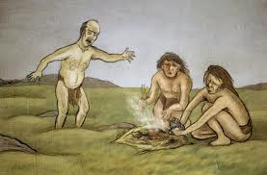
Informal Government
Informal Government: government that rules over small groups of people.
Example: Early Humans had an informal government, they lived in small groups and would elect the best type of hunter or wisest leader.
Please write this.

Slide 8
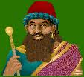
Formal Government
Formal Government: government that rules over LARGE groups of people.
Example: In Babylon Hammurabi was the King. Hammurabi ruled over the entire Babylonian city-state (this is a large area!)
Please write this.

Slide 9
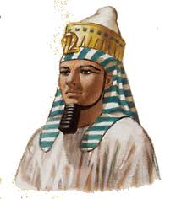
Monarchy
Monarchy: one ruler in charge who receives their power through heredity.
Example: Ramses II (of Egypt) was a Monarch. He was one ruler who received his rule when his father died.
Please write this.

Slide 10
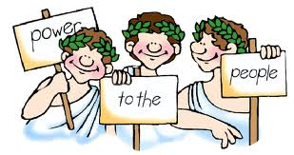
Indirect vs. Direct Democracy
Indirect Democracy (a.k.a. a Republic)- when citizens elect officials (or representatives) to represent them in the government.
First seen in Ancient Rome.
Direct Democracy- all citizens vote on all decisions
First seen in Athens, Greece.
Please write this.

Slide 11
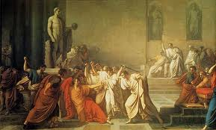
Republic
Please write this.
Republic: (same thing as Indirect Democracy)- when citizens elect officials (or representatives) to represent them in the government.
Example: Rome had an elected senate that made most of their decisions.
Caesar is being murdered by the members of the Senate who thought he had too much power!

Slide 12
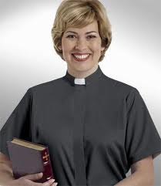
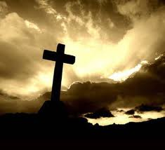
Theocracy
Please write this.
Theocracy- a government ruled by the church and church officials (monks, clergy, nuns, priests etc.)

Slide 13
Group Practice With TCAP Questions! *Your teacher will read the questions and give you 20 seconds to come up with an answer, we will then poll the class to see how we did and go over the correct answers!

Slide 14
The correct answer would be D, because in a direct democracy all citizens vote on all laws/issues!
It can’t be defend their country because that is not a government.
When it says elect senators- that would be an Indirect Democracy because they’re voting for representitives

Slide 15
The correct answer is D – Roman, Rome had an emperor (Caesar!), they also had a senate (the representatives who voted), and Rome had a forum (the center of the city) where the 12 tables were posted!
It can’t be A because China did not have a senate they had a monarchy.
It can’t be Egyptian because they also had a monarchy and no senate. Also their leader was called a Pharaoh not an emperor.
It cannot be Mesopotamian because they had Kings and a monarchy.

Slide 16
The correct answer is C- Democracy. We remember democracy because it is power to the people! All people get to vote in a democracy.
The answer can’t be monarchy because the king/queen/emperor/pharaoh has all of the power
The answer can’t be dictatorship because in a dictatorship ONE person holds all the power receiving it by force.
Lastly, it cannot be a plutocracy because only wealthy people have power in this system. (AND….we haven’t even learned about it!)

Slide 17
The correct answer is D – Theocracy. We discussed that the prefix “Theo” is gods/logic (having to do with religion) so anytime we see “Theo” we think religion!
It can’t be monarchy because the power belongs to one king or queen.
Democracy cannot be correct because democracy is POWER TO THE PEOPLE! The people have the power.
The answer cannot be anarchy because (we haven’t even learned about it and an anarchy is a lawless society! (YUP! They have no laws!)

Slide 18
The correct answer is C. We know that Nomads travel from place to place looking for food. The best leader for that nomadic tribe would be one who could help the tribe get the most food! If the leader knows the patterns of animal migration (or movements) they would be the best person for the job!

Slide 19
What was the government like in ancient hunter-gatherer communities?
A. The family was the basis of government-like control
B. Tribes banded together and organized federations
C. Elected chiefs ran the villages
D. Decisions were made in community meetings held twice a year.
We know that hunter-gatherer communities had INFORMAL government. They had small groups. That eliminates choice B that tribes banded together, it also eliminates C because there were no “villages” yet, and lastly it eliminates D because there were no communities to make decisions!
The correct answer would be A- the family was the basis of government like control! For example – your family is an informal government which means your Mom or Dad is the leader of your family, they make the rules!

Slide 20
Quiz Your Partner!
Same exact way we did it yesterday we are going to work to quiz our partners. You will receive a worksheet with the questions. As your partner the questions and then check off if they get it right/ Switch roles and do the same
Continue quizzing until both partners have all checks!

