Slide 1
WRITING WEDNESDAY!
Week 4 Writing March 2011

Slide 2
Agenda
1. Steps to looking at a picture
2. Group practice
3. Independent practice

Slide 3
Steps to find the message in a picture
Write this down in your notebook!
1. Observe what’s in the picture
2. Read the answer choices
3. Which choice are you sure is occurring in the picture?
Eliminate answer choices that cannot be inferred from the picture. Choose the answer that you KNOW based on the picture
ASK YOURSELF: DO I KNOW THIS FROM THE PICTURE?
SPI 0601.7.5 Choose the statement that best summarizes the message of a medium.

Slide 4
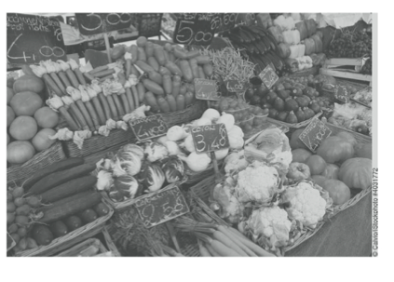
The steps in action…
1. What’s in the picture?
SPI 0601.7.5 Choose the statement that best summarizes the message of a medium.

Slide 5
The steps in action…
1. What’s in the picture?
Answer:
Lots of vegetables in baskets with price tags
SPI 0601.7.5 Choose the statement that best summarizes the message of a medium.

Slide 6
The steps in action…
Step 2: Read the choices
A farmers’ market plans to use this photo in an advertisement. What message are the farmers most likely trying to communicate with this photo?
A. Their prices are comparable to supermarket prices.
B. They offer a variety of fresh produce.
C. They handpick all of the vegetables.
D. Their produce is grown on land nearby.

Slide 7
The steps in action…
Step 3: Which choice are you sure is occurring in the picture?
A farmers’ market plans to use this photo in an advertisement. What message are the farmers most likely trying to communicate with this photo?
A. Their prices are comparable to supermarket prices.
B. They offer a variety of fresh produce.
C. They handpick all of the vegetables.
D. Their produce is grown on land nearby.

Slide 8
The steps in action…
Step 3: Which choice are you sure is occurring in the picture?
A farmers’ market plans to use this photo in an advertisement. What message are the farmers most likely trying to communicate with this photo?
A. Their prices are comparable to supermarket prices.
B. They offer a variety of fresh produce.
C. They handpick all of the vegetables.
D. Their produce is grown on land nearby.

Slide 9
The steps in action…
Step 3: Which choice are you sure is occurring in the picture?
A. Their prices are comparable to supermarket prices.
I can see price tags, but I do not see a comparison to supermarket prices. In fact, I can’t even tell what the prices are for!
B. They offer a variety of fresh produce.
Variety means many different kinds. Produce = fruits/vegetables. I see at least 14 different vegetables. That is a variety!
C. They handpick all of the vegetables.
There is no way for me to know based on this photo that the vegetables were handpicked.
D. Their produce is grown on land nearby.
Produce = fruits/vegetables. There is no way for me to know based on this photo that the vegetables were grown on land nearby.

Slide 10
The steps in action…
Step 3: Which choice are you sure is occurring in the picture?
A. Their prices are comparable to supermarket prices.
I can see price tags, but I do not see a comparison to supermarket prices. In fact, I can’t even tell what the prices are for!
B. They offer a variety of fresh produce.
Variety means many different kinds. Produce = fruits/vegetables. I see at least 14 different vegetables. That is a variety!
C. They handpick all of the vegetables.
There is no way for me to know based on this photo that the vegetables were handpicked.
D. Their produce is grown on land nearby.
Produce = fruits/vegetables. There is no way for me to know based on this photo that the vegetables were grown on land nearby.

Slide 11
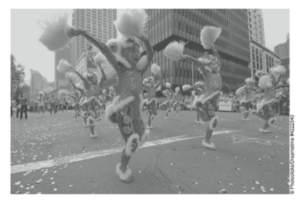
Let’s try it!
1. What’s in the picture?
2. Read the answer choices
3. Which choice are you sure is occurring in the picture?
From this photo, a viewer can conclude that the children…
A. enjoy traveling to different cities to dance
B. have never done this dance before
C. are in the United States
D. are performing at a festival.
SPI 0601.7.5 Choose the statement that best summarizes the message of a medium.

Slide 12
Let’s try it!
1. What’s in the picture?
2. Read the answer choices
3. Which choice are you sure is occurring in the picture?
From this photo, a viewer can conclude that the children…
A. enjoy traveling to different cities to dance
B. have never done this dance before
C. are in the United States
D. are performing at a festival.
SPI 0601.7.5 Choose the statement that best summarizes the message of a medium.

Slide 13
Steps to find the mood of a picture
Sometimes you will have to determine the “mood” of a photo
You will be given 4 adjectives, and you need to pick the one that matches the photo.
Look at the people’s facial expressions and body language. Show your coach how you would show the following adjectives:
Scared, happy, sad, angry, surprised, focused
SPI 0601.7.5 Choose the statement that best summarizes the message of a medium.

Slide 14
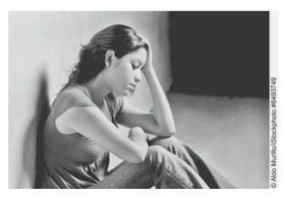
Let’s try it!
1. What’s in the picture?
2. Read the answer choices
3. Which choice are you sure is occurring in the picture?
4. What if we don’t know what “modest” means?
The girl in this picture appears to be
A. surprised. B. outraged.
C. modest. D. upset.

Slide 15
Let’s try it!
1. What’s in the picture?
2. Read the answer choices
3. Which choice are you sure is occurring in the picture?
4. What if we don’t know what “modest” means? We still know she is upset!
The girl in this picture appears to be
A. surprised. B. outraged.
C. modest. D. upset.

Slide 16
Steps to find the inferred message of a picture
Sometimes the message isn’t as obvious
You will need to put together clues in the picture to get to the correct answer choice
But the steps are the SAME
Still ask yourself what you can determine from the picture. You need to then turn the contents of the picture into a message. A message is not a description. A message if the point of the photo, or what you could use the photo to say if you didn’t have words.
SPI 0601.7.5 Choose the statement that best summarizes the message of a medium.

Slide 17
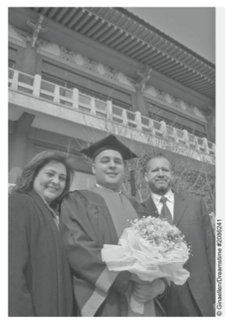
Let’s try it!
Choose the statement that best summarizes the message of this picture.
A. Students at graduation can expect to be successful in life.
B. Graduation day is a proud event for a student and his family and friends.
C. A student smiles for a picture on graduation day.
D. Parents discuss plans for the future at the graduation for their son.
1. What’s in the picture?
2. Read the answer choices
3. Which choice are you sure is occurring in the picture?

Slide 18
Let’s try it!
Choose the statement that best summarizes the message of this picture.
A. Students at graduation can expect to be successful in life.
Even if I think students who graduate will be successful, the picture doesn’t tell me that.
B. Graduation day is a proud event for a student and his family and friends.
I know if is graduation day. There is a student in the picture with his family. Based on their expressions, they look happy and proud.
C. A student smiles for a picture on graduation day.
This is exactly what is going on in the picture, but there is no message in this option.
D. Parents discuss plans for the future at the graduation for their son.
No one is discussing in this photo.

Slide 19
Independent Practice!
Complete this worksheet on your own.
Your coach will review the answers with you in approximately 5 minutes!

Slide 20
Extra time?
You will also have questions that ask you to choose the best visual (picture/video/chart/graph) to support the message of a speech.
Remember… the point of the visual has to match the point of the speech!

Slide 21
Extra Time?
Melissa is giving a presentation to persuade students that CPR (cardiopulmonary resuscitation) is an important skill to know.
Which of these would best reinforce her viewpoint?
A. an original photograph of the person who invented CPR
B. a diagram explaining the parts of the emergency room
C. an illustration of the heart and the circulatory system
D. a chart showing the number of lives saved by CPR

Slide 22
Extra Time?
Roberto is giving a speech to encourage people to recycle plastic materials. Which of these would be best for him to show the audience at the end of his speech?
A. a magazine article about garbage
B. a picture of plastic bottles and forks
C. a photograph of a school playground
D. a small chair made from recycled plastic

