Slide 1
Seating Chart Period : 1 Section: 6-03
1
2
3
4
5
6
Tiequan
Sam
Kiahnna
Travius
Dominique
Brianna
7
8
9
10
11
12
13
14
Hannah
Tyler
Kenneth
Rodrigo
Kovi
Kelsey J
Kelsey R
15
16
17
18
19
20
Sharaven
Le’Jalon
Erin
Nicole
Garrett
Ben
Kiara
DeAndrea’
Teacher Desk
21
22

Slide 2
Seating Chart Period : 2 Section: 6-04
1
2
3
4
5
6
Allen
Dezmond
Sydney
Precious
Raven
Myron
7
8
9
10
11
12
13
14
Joshua
Vernisha
Tahnee
Nia
Kinnidy
Kyra
Akil
D.J.
15
16
17
18
19
20
NyJavian
Jeremiah
Tyehimba
Rashad
Rikyah
Jaelynn
21
22
Teacher Desk
Alfred
Keelen

Slide 3
Seating Chart Period : 3 Section: 6-05
1
WatsonElijah
4
6
2
3
5
Kameron
Donald
Nickolas
Arielle
Tanzania
7
8
9
10
11
12
13
14
Elisha
Mya
Whitney
Jasmine
Michael H
Michael M
Ariana
Tamia
15
16
17
18
19
20
Mikala
Miracle
Kelsey
Denise
Isaiah
21
22
Michael L
Teacher Desk
Zaria
Brianna

Slide 4
Seating Chart Period : 6 Section: 6-01
Jordan
4
Cameron
1
2
3
5
6
Marquavious
Lloyd
Frederick
Jamaria
7
8
9
10
11
12
13
14
Carlton
Zaria
Ashton
Jason
Jerrica
Shariah
Destiny
Shane
15
16
17
18
19
20
Olivia
Jumia
Breana
Lauren
Asia
Janaesha
21
22
Teacher Desk
LaJuan
Antonio

Slide 5
Seating Chart Period : 7 Section: 6-02
1
2
3
4
5
6
Makajia
Mariah
TaTyana
Emily
DeAsijah
Jada
7
8
9
10
11
12
13
14
Aaroneika
Tia
Wayne
Marshall
Elizabeth
Sheredith
Tiarrne
Anber
15
16
17
18
19
20
Jerry
Elijah
Gabriel
Chris
Greg
21
22
Teacher Desk
Jared
Kimeidra

Slide 6
Catalyst (5 minutes)
What other objects are there in our solar system besides our planets? Name one thing you learned in your homework last night about one of these objects.
In the BrainPop video on the Solar System, what iss located between the planets of Mars and Jupiter? What is this object?
What can we classify our Sun as? What size and color is our Sun? What temperature is our Sun then?

Slide 7
Study Island Lesson: Objects in Space
Today we are going to learn more about the other objects in our solar system.
We will learn about this more through the lesson on Study Island (www.StudyIsland.com ).
You need to go to Science (old)
You may only read the lesson today, we will have the opportunity to do the quiz on Island Friday!
Fill out the worksheet as you go.
By the end of this week, you need to know the definition and characteristics of the following:
- Stars - Comets - Meteoroids
- Asteroids - Meteors - Meteorites

Slide 8
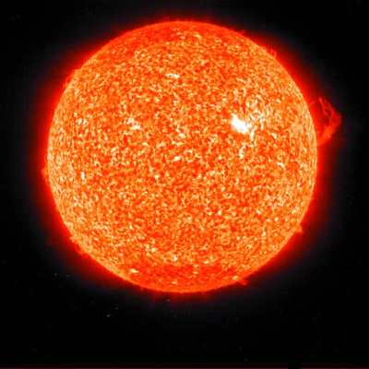
Stars
Big burning balls of gas!
Stars vary greatly in size, temperature, & color
Our sun is an average-sized star.
Larger stars are cooler!
Smaller stars are hotter!
From our Homework Monday night
Stars give off light and heat energy
Our sun gives off a yellow light.
Hotter stars appear blue or white.
Cooler starts appear orange or red.

Slide 9
What color are stars?
Hot __________
Warm _________
Cool ________
What size are stars?
Hot __________
Warm _________
Cool ________

Slide 10
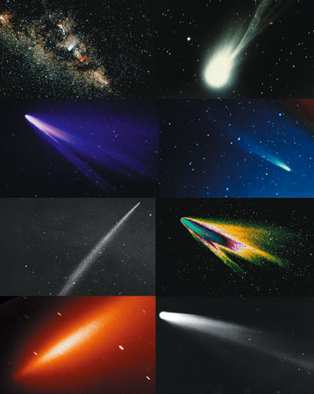
Comets
Comets have an elliptical orbit (shaped like an oval)
They move into the solar system for a short time, then move back out way past Pluto – and are not seen again for many years!
Smaller than planets, moons, or asteroids
They are usually very hard to see, but as they approach the sun, the particles heat up and give the comet a distinct tail.
From our Homework Monday Night:
A comet’s tail is always point away from the Sun.
We can sometimes see a comet in our night sky!

Slide 11
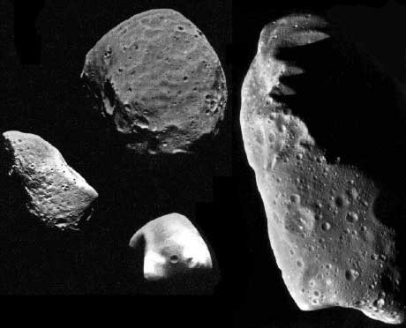
Asteroids
The majority of asteroids are found in the space between Mars and Jupiter (“Asteroid Belt”)
They vary greatly in size and shape.
They are made up of stone, iron, and nickel
From Homework Monday Night:
Astronomers think the asteroids may be what are left of a planet that broke up long ago.
Scientists believe that in the past asteroids may have hit Earth.

Slide 12
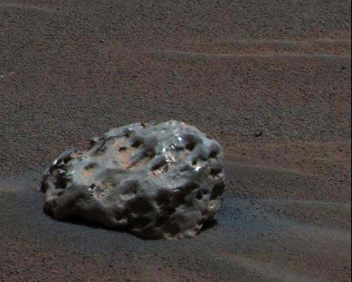
Meteorites
Meteorites are only found on the surface of planets.
Most meteorites are created as a result of collisions of asteroids, comets, moons, and even planets within our solar system.
Meteorites can be stony, stony iron, or just iron (depending on where they came from)
From Homework Monday Night:
Some meteorites have hit Earth in the past and left huge craters!
There are craters on the surface of the moon from being hit by meteorites in the past.

Slide 13
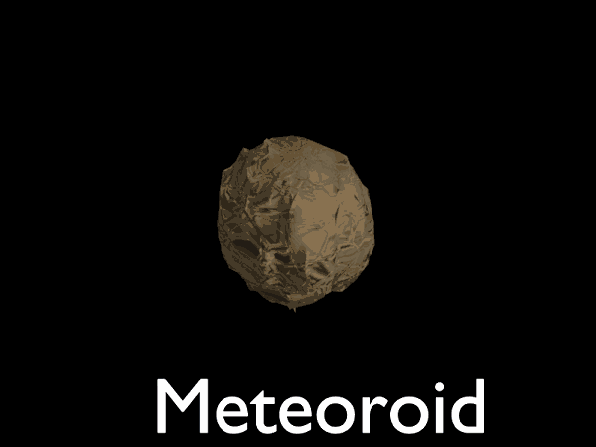
Meteoroids
A meteoroid is matter revolving around the Sun or any object in space too small to be called an asteroid or a comet.
Most meteoroids are created as the result of collisions of asteroids, comets, moons, and even planets within our solar system.

Slide 14
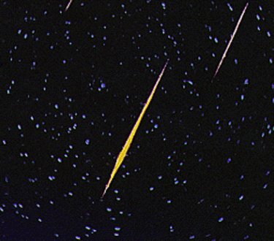
Meteors
When a meteoroid flies into the atmosphere, it gets very hot and begins to burn up. While it is burning up, it is called a meteor.
Meteors can sometimes be seen from Earth as a “shooting star.”
If it doesn’t burn completely in the atmosphere, it will hit the surface of Earth and be called a meteorite.

Slide 15
Flip over your Cornell Notes
With a partner, read though the reading once again.
As you go through each paragraph, make sure you are answering the questions as well!
These questions will help you get familiar with the different objects we learned about today, and will help you prepare for this Thursday’s quiz!
If you finish early, raise your hand

Slide 16
Tonight ….
Get started on your notecards early!
Wednesday night: you will also have a crossword puzzle to complete for homework
Thursday: your notecards and completed crossword puzzle will be due
Make sure you have index cards for this semester!!!

