Slide 1
Social Studies Jobs
6.1.spi.2: The student is able to identify the job characteristics of archaeologists, anthropologists, geologists and historians.

Slide 2
Copy the following slides into your notebooks!
While your teacher reads them out loud to you!

Slide 3
Question of the Day!
Diaries, interviews, recordings, publications, government records, clothing
The items above are most helpful to:
a. geologist
b. geographer
c. historian
d. arcaheologist

Slide 4
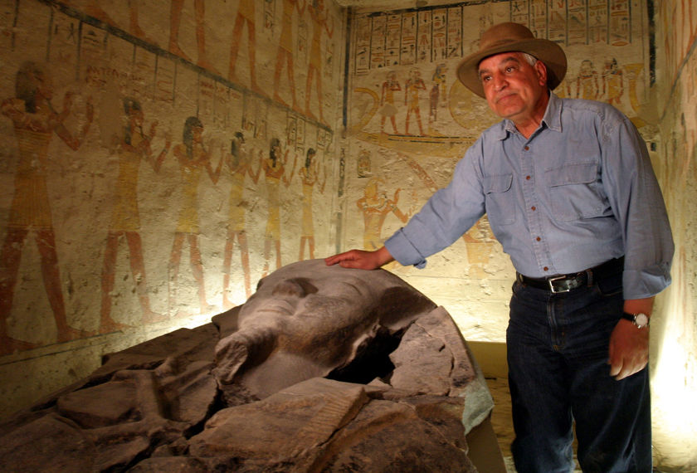
Archaeologists
What do they study?
Archaeologists study prehistoric and ancient cultures.
How do they study?
Archaeologists hunt for evidence buried in the ground like bones, tools, and artifacts.

Slide 5
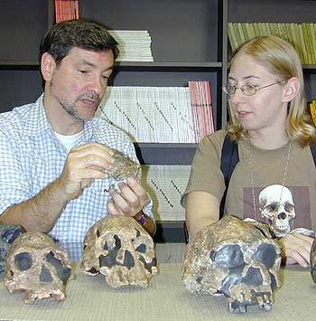
Anthropologists
What do they study?
Cultural anthropologists study human societies, their cultures and characteristics.
Physical anthropologists study what early hominids looked like and how they lived and died.
How do they study?
Cultural anthropologists interview people and observe them as they go about their daily lives.
Physical anthropologists study fossil remains of hominids.
Remember!
Hominid = early human skulls
Fossil = the remains of plant or animals in past ages

Slide 6
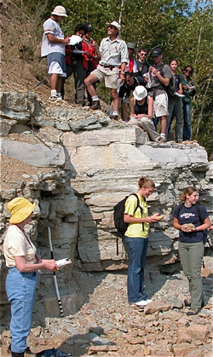
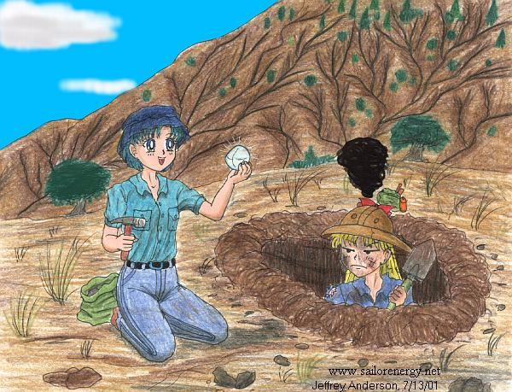
Geologists
What do they study?
Geologists study what the earth is made of, how it has changed in the past, and how it is changing now.
How do they study?
Geologists study rocks and other physical features.

Slide 7
STOP! Check for Understanding…
What is the difference between an Archaeologist and a Geologist?

Slide 8
The Difference…
Archaeologist
Geologist
They dig for ancient artifacts such as bones, and tools.
They dig in order to find Rocks & what the earth is made of.

Slide 9
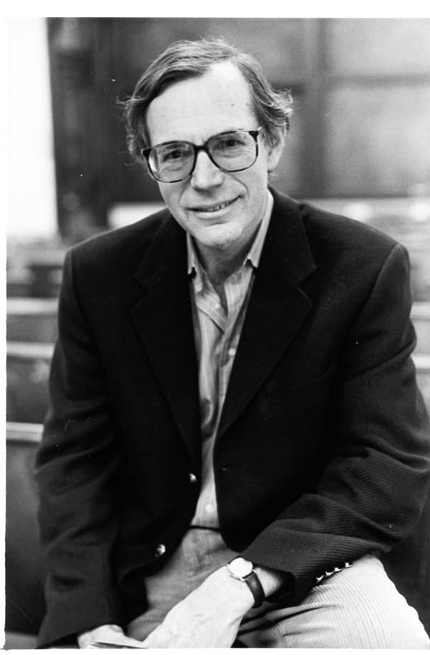
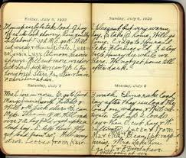
Historian
What do they study?
Historians study past events, people, and societies.
How do they study?
Historians study written records, physical remains and artifacts.
Examples: diaries, recordings, publications, government records, clothing

Slide 10
Practice
Which of the following is a job completed by a geologist?
a. the geologist digs in order to find ancient artifacts.
b. the geologist digs in order to look at rocks and other parts of the earth’s remains.
c. the geologist reads documents such as primary and secondary sources in order to learn more about history.
d. the geologist studies human culture and early hominids.

Slide 11
Practice – Using your white boards!
Your teacher will put up a slide, and it is your job on your white board to write which job the description applies to.
Your teacher will put up the slide and you will have 15 seconds to put complete your answer.
When your teacher says “Boards up!” that’s when you put your board in the air.
Historian
Archaeologist
Anthropologist
Geologist

Slide 12
Question #1 ~ Who Am I?
I study……
Rocks, dirt and other remains on the earths surface.

Slide 13
A Geologist!
Geologists study rocks and the earth’s surface!

Slide 14
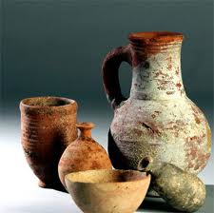
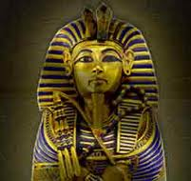
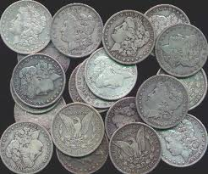
Question #2- Who Am I?
I study……

Slide 15
An Archaeologist!
All of those images are artifacts that an archaeologist would dig for!

Slide 16
Question #3- Who Am I?
I study……
The Diary of Anne Frank to get a better understanding of the history of Germany.

Slide 17
Historian!
Historians study primary and secondary sources. A diary is an example of a primary source that a Historian would use.

Slide 18
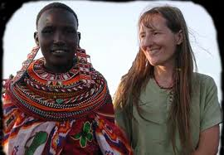
Question #4- Who Am I?
This is a picture of me doing my work…

Slide 19
Anthropologist!
The anthropologist submerges themselves in another groups culture to learn more about the groups lifestyles and customs.

Slide 20
Question #5- Who Am I?
I study……
The origin and behavior of Man.

Slide 21
Anthropologist!
Anthropologists study early people (hominids)!

Slide 22
Question #6
This is a description of what I do:
________ study events, ideas, institutions, and individuals of the past. They may research and interpret events that occurred in the earliest periods of recorded time or ones that people can remember., ___________ rely mostly on written records for evidence to support their claims. However, ____________ sometimes use physical objects, such as photographs, costumes, and tools, to shed light on past lifestyles.

Slide 23
Historians!

Slide 24
Question #7
(Only put the correct letter…)
The items below are descriptions of which social studies job
a. Historian
b. Anthropologist
c. Geologist
d. Archaeologist
-Early man
-Skulls
-Human Culture and Customs

Slide 25
Copy the chart below and match the job to its description
Job | Description
a. Anthropologist | 1.___ I study the earths surface, rocks and physical remains.
b. Archaeologist | 2.___ I study early man (hominids) and the various cultures around the world.
c. Historian | 3.___ I study documents such as books, letters, government papers
d. Geologist | 4.___ I study pots, bones, coins, or any other ancient artifacts by digging in the ground.

Slide 26
How Did You Do?
1. D
2. A
3. C
4. B

Slide 27
If you got them all right give yourself a pat on the back!

Slide 28
Once you have finished the chart…
Log on to Study Island and work on the quiz “Social Studies Jobs TCAP Review”
YOUR GOAL IS TO SCORE ABOVE 80%!
Once you have finished that assignment, log onto Quia and play the Social Studies Jobs Rags to Riches Game

