Slide 1
Catalyst (5 minutes)
Come in silently and get out a new sheet of paper for this week’s catalysts:
What is electrical energy?
Through what kinds of things have we learned that electrical energy can flow?
Name some things that you know require electrical energy to run. List the parts of these items that help to make them work.

Slide 2
Put together last week’s catalyst for collection!
Empty out the right side of your folder and organize the papers into your binder!
Homework from last Monday and Wednesday Night: Homework Section of your binder!
Make sure you have all 55 notecards on your vocab ring!
11 from Scientific Investigation
29 from Ecology
15 from Energy
Nothing should be in the pockets of your folder or binder!

Slide 3
Unit 3: Electricity!
Week | Topic learned
Week 1 November 8-12th | Parts Electric Circuits Types of Electric Circuits
Week 2 November 15-19th | Conductivity Insulators versus Conductors
Week 3 November 22nd & 23rd | Monday, Nov. 22nd : Review Tuesday, Nov 23rd : Test

Slide 4
Turn to page 436 in your textbooks.
Chapter 14 Section 4: Electric Circuits

Slide 5
Electric Circuit
A complete, closed path through which electric charges flow.

Slide 6
All simple circuits need three basic parts:
An energy source
Wires
A load

Slide 7
Load
Change electrical energy into other forms of energy
These other forms might include thermal energy, light energy, or mechanical energy
Look at Figure 1 on the bottom of page 436. What are examples of loads in the picture?
Light bulbs
Appliances
Televisions
Motors

Slide 8
Energy source
Look at Figure 1 on page 436.
What are examples of energy sources?
Batteries
Photocells
Thermocouples
Electric generator at a power plant

Slide 9
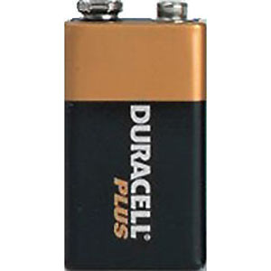
Batteries
Batteries use chemical energy to generate electrical energy for an electric circuit.

Slide 10
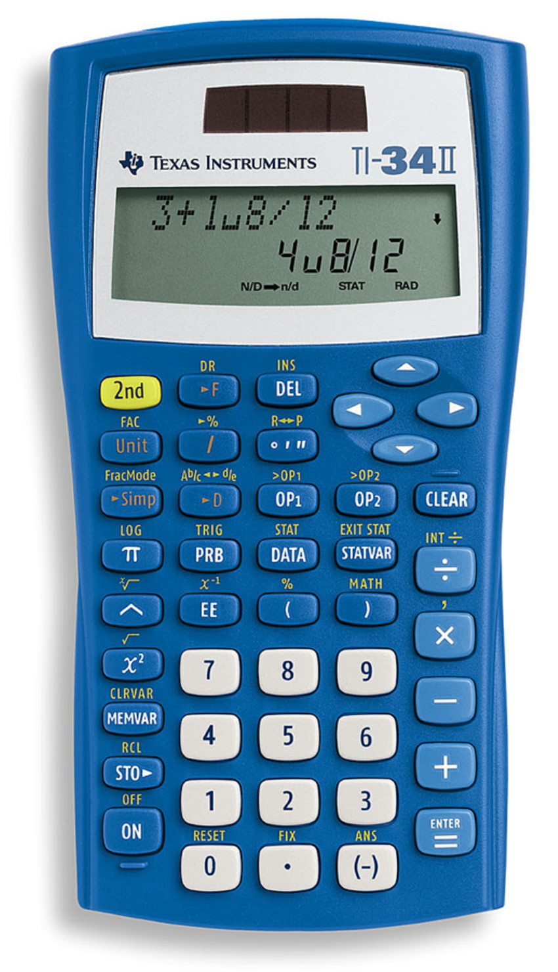
Photocells
Photocells use the sun’s light (solar energy) to generate electrical energy for an electric circuit

Slide 11
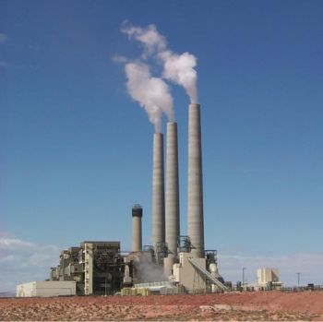
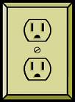
Electric generator at a power plant
Every time you plug something into an outlet, chances are that the electricity was generated at a coal-powered power plant!

Slide 12
A Switch to Control a Circuit
A switch is used to open and close a circuit
For charges to flow through a circuit, the switch must be closed, or turned “on”
When the switch is open, or “off,” the loop of the circuit is broken.
Charges cannot flow through a broken circuit.
Light switches, power buttons, and even keys on calculators can open and close circuits.

Slide 13
Examples of Electric Circuits
Using the worksheet on the back of your Cornell notes, work with a partner to identify the three basic parts of the circuit.
Where is the energy source?
Where are the wires through which the electric current flows?
Where is the load?
Into what kind of energy does the load change the electrical energy?

Slide 14
Homework tonight
Read the lesson first.
Answer the first three questions on your own sheet of paper after reading the first page.
Answer the last three questions on your own sheet of paper after reading the back of the lesson.
Answer all questions in complete sentences.

