Slide 1
Catalyst (5 minutes)
Read the following definitions. Use your Cornell notes and notecards to help you identify which terms from yesterday’s lesson matches the definitions:
This form of energy is created by the motion of particles within an object. Temperature depends on this form of energy.
This form of energy is the total energy of motion and position.
This form of energy is made from the vibrations of an object.

Slide 2
Whiteboard Practice

Slide 3
Identify this example as a form of energy …
What kind of energy powers a blow dryer?

Slide 4
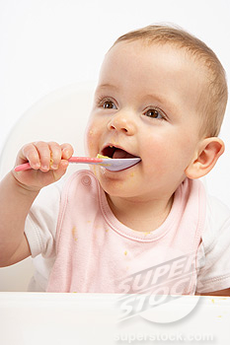
Identify this example as a form of energy …
From which form do humans get their energy?

Slide 5
Identify this example as a form of energy …
The light given off from a candle flame?

Slide 6
Identify this example as a form of energy …
The moving blades of a fan.

Slide 7
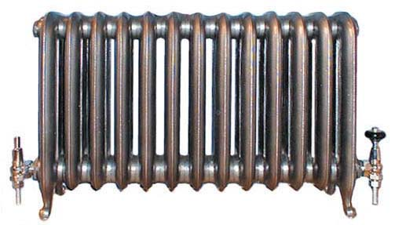
Identify this example as a form of energy …
The heat produced by a radiator.

Slide 8
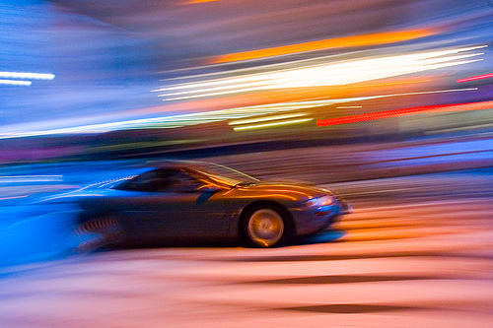
Identify this example as a form of energy …
The sound of a car speeding past.

Slide 9
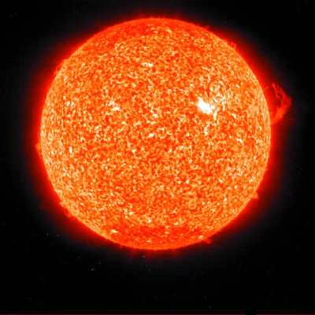
Identify this example as a form of energy …
The sun’s energy.

Slide 10
Partner Reading Chapter 12 Section 2: Energy Conversions
Remember how we read from our textbook, stopping after each section to think about what we just read and answer questions.
Today, you will practice reading your textbook with a partner.
There are 5 sections, so you will need to alternate reading aloud, and one partner will read 3 sections while one partner reads 2 sections.
You may scoot your desks and/or chairs into a more isolated part of the room so that you and your partner can focus!
Make sure you are staying on-task and being respectful of other pairs around you, I will be circulating the room to make sure you are making the right choices and to answer any questions your might have!

Slide 11
Looking at Real Examples of Energy Conversions: BLOW DRYER
Observe very carefully everything that is involved in turning the blow dryer on
What do you see, hear, feel when the blow dryer was turned on?
What energy conversions are taking place here?
_________ energy → _________ energy
_________ energy → _________ energy
_________ energy → _________ energy

Slide 12
Looking at Real Examples of Energy Conversions: MATCH BEING LIT
Observe very carefully everything that is involved in lighting the match
What do you see, hear, feel when the match was being lit?
What energy conversions are taking place here?
_________ energy → _________ energy
_________ energy → _________ energy
_________ energy → _________ energy

Slide 13
Looking at Real Examples of Energy Conversions: FAN
Observe very carefully everything that is involved in turning the fan on
What do you see, hear, feel when the fan was turned on?
What energy conversions are taking place here?
_________ energy → _________ energy
_________ energy → _________ energy
_________ energy → _________ energy

Slide 14
BrainPop Video: Forms of Energy
As you watch the video, listen carefully to how Tim & Moby explains energy
We will have questions using our whiteboard after the video!

Slide 15
Homework Due Monday
Make an ENERGY COLLAGE.
Use 1 sheet of construction paper or computer paper.
Use pictures from magazines, newspapers, the Internet, or you can draw pictures.
You must have pictures that represent at least 5 different forms of energy on your collage.
Label each picture using the correct form of energy.
Start working on it now so you don’t have to cram it in over the weekend!

Slide 16
Literacy Night: Monday, October 25th
As a homeroom, we will put together a display representing one country from around the world!
We may choose from the following countries:
China
Japan
Korea
Germany
France
Scandinavia
England
Every scholar will be expected to contribute to the display!
Biography & photo of a famous author
Summary/pictures of a famous story/folktale
Paragraph describing the basic history
Paragraph describing the daily life of a person who lives in this country
Paragraph describing the culture
Paragraph describing the religion
Paragraph describing the literacy rates
Someone to help assemble our display after school next Thursday, October 21st
Presenter who is familiar with all of the information and who will be in attendance on Monday, October 25th
Spain
Mexico
Italy
Russia
India
United States
West Africa

