Slide 1
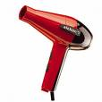
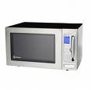
Catalyst (5 minutes)
What happens to the potential energy of a snowboarder once he starts to snowboard down the side of a mountain?
As a tennis ball bounces up, back into your hand, what happens to its gravitational energy?
A blow dryer. A desk lamp. A microwave. An Xbox 360. What do all of these have in common? (*hint: think about what we’re talking about for this unit)

Slide 2
Put together your week’s catalyst for collection!
Empty out the right side of your folder and organize the papers into your binder!
Cornell Notes: Classwork Section of your binder!
Homework from Wednesday Night: Homework Section of your binder!
MAKE SURE YOUR NOTECARDS ARE HOLE-PUNCHED & added to the ENERGY section of your vocab ring!
Nothing should be in the pockets of your folder or binder!

Slide 3
Congratulations to our All-Star & Super Star Scholars
All-Star Scholars of September 2010
6-03: Erin Massey
6-04: Rashad Lipford
6-05: WatsonElijah Williams
6-01: Shariah Edwards
6-02: Wayne Seymour
These scholars will receive a $100 bonus on their September paychecks and will be invited to special events throughout the year!
Super Star Scholars
These scholars averaged an A on all of their weekly quizzes and received a 100% on their first unit test!
6-03: Rodrigo Araujo, Nicole Lay & Tyler Smith
6-04: Tyehimba Naantaanbuu
6-05 : Arielle William & Ariana Williams
6-01: Jumia Callaway
We will meet today @ lunch!

Slide 4
Turn to page 349 in your textbooks

Slide 5
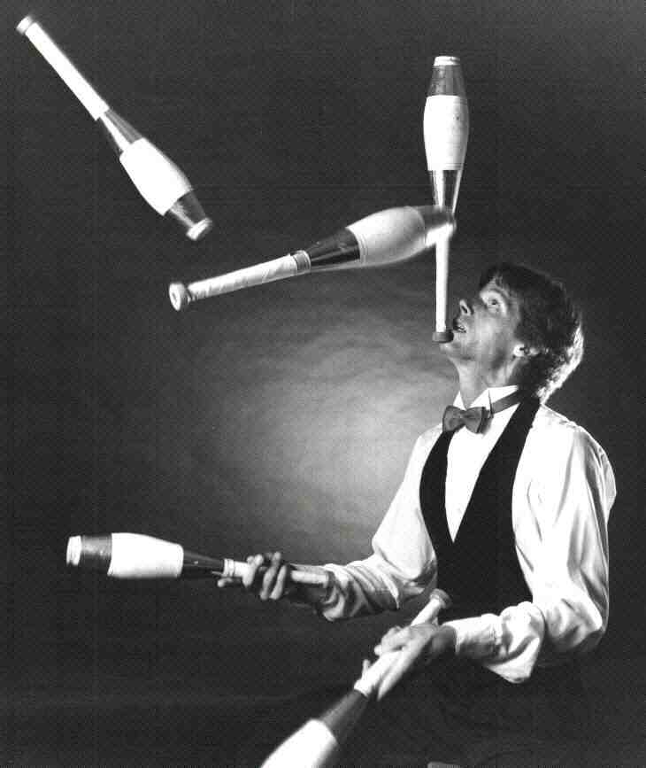
Mechanical Energy
The total energy of motion and position of an object

Slide 6
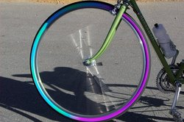
Example of Mechanical Energy
Anything that can be put into motion
A spinning wheel has mechanical energy that is kinetic .
When the wheel is still is has mechanical energy that is potential.

Slide 7
Thermal Energy
All of the kinetic energy due to random motion of the particles that make up an object.
The hotter something is, the more kinetic energy its particles have.
If something is cold, like ice, its particles are moving very slow, or have little kinetic energy.

Slide 8
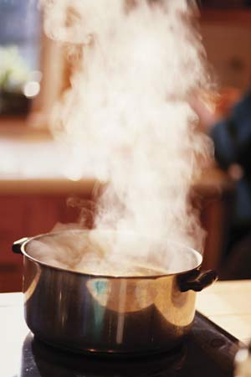
Example of Thermal Energy
Anything that has a temperature.
Water has thermal energy.

Slide 9
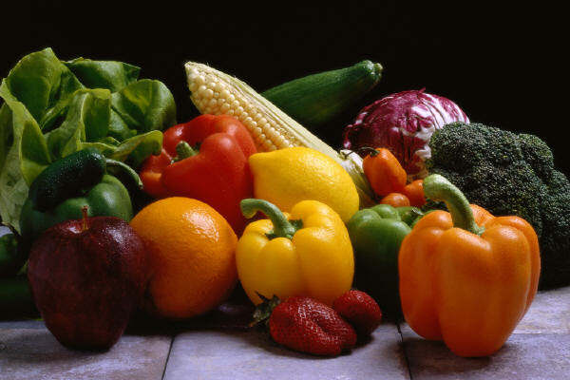
Chemical Energy
The energy of a compound as its atoms are rearranged.

Slide 10
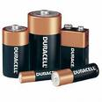
Example of Chemical Energy
Inside of batteries are chemicals that help provide the energy that powers things like calculators, toys, handheld games, and more!
Chemical energy is almost always in the form of chemical potential energy!

Slide 11
Electrical Energy
The energy of moving electrons.
A.k.a. electricity!

Slide 12
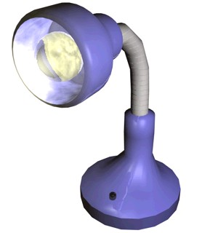
Example of Electrical Energy
Anything that is powered by electricity requires electrical energy!
Everyday appliances, like lamps, need electrical energy!

Slide 13
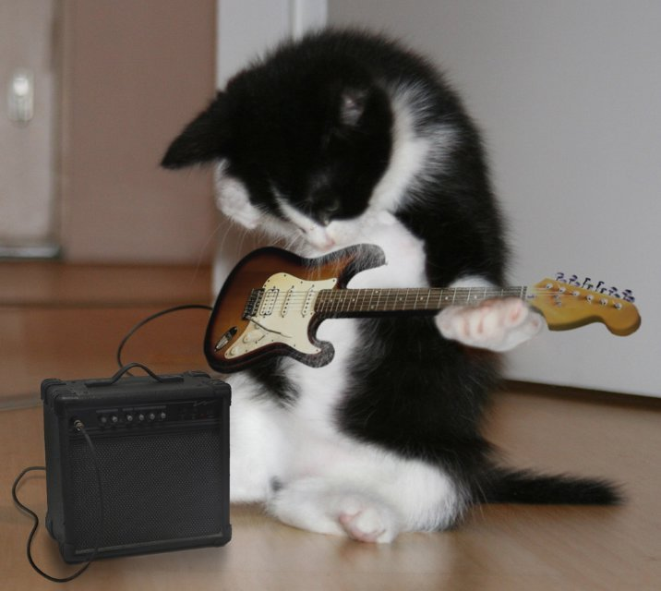
Sound Energy
An object’s vibrations transmit sound energy through the air.

Slide 14
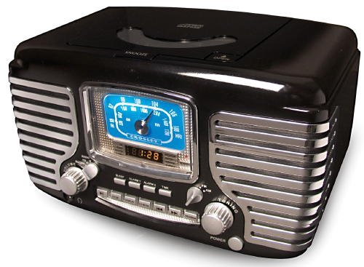
Example of Sound Energy
Anything that produces sound is giving off sound energy!
A radio playing music gives off sound energy!

Slide 15
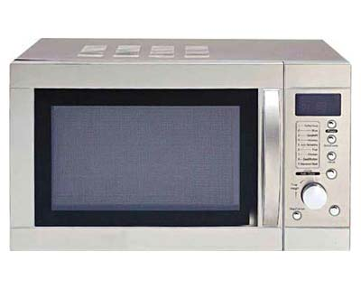
Light Energy
Produced by vibrations of electrically charged particles.

Slide 16
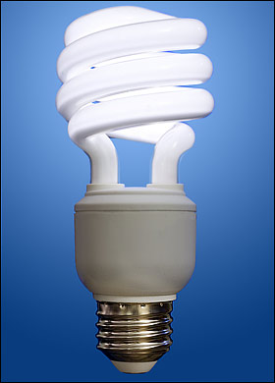
Example of Light Energy
Anything that produces a form of light!
Light bulbs give off light energy

Slide 17
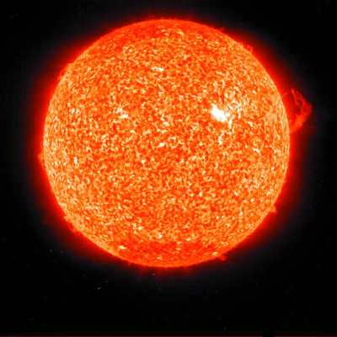
Nuclear Energy
Energy that comes from changes in the nucleus of an atom.

Slide 18
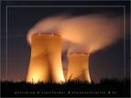
Example of Nuclear Energy
The sun is a natural example of nuclear energy.
Humans have also figured out a way to produce electricity using nuclear energy.

Slide 19
Whiteboard Practice

Slide 20
Identify this example as a form of energy …
What kind of energy powers a blow dryer?

Slide 21
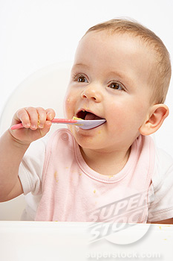
Identify this example as a form of energy …
From which form do humans get their energy?

Slide 22
Identify this example as a form of energy …
The light given off from a candle flame?

Slide 23
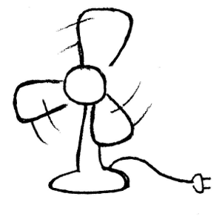
Identify this example as a form of energy …
The moving blades of a fan.

Slide 24
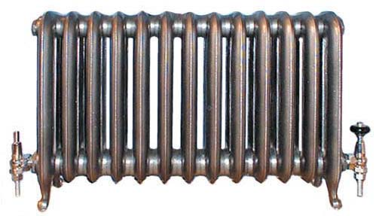
Identify this example as a form of energy …
The heat produced by a radiator.

Slide 25
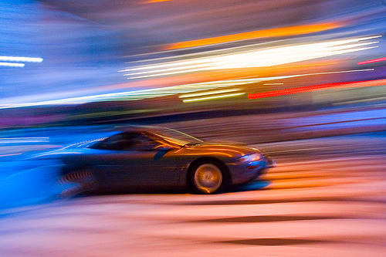
Identify this example as a form of energy …
The sound of a car speeding past.

Slide 26
Identify this example as a form of energy …
The sun’s energy.

Slide 27
Over Fall Break:
Make 7 notecards for your new vocabulary.
On the back, please write the definition AND the example we talked about today!
Use your Cornell notes and your textbook to make sure every term and definition is finished on your vocab ring!

