Slide 1
Catalyst (5 minutes)
Identify the following example as potential or kinetic energy:
An apple hanging from a tree.
Identify the following example as gravitational or elastic potential energy:
A book on a bookshelf.
Identify the following example as elastic or chemical potential energy:
A spring that has been stretched.

Slide 2
Practicing with whiteboards

Slide 3
Potential or Kinetic?
A rolling ball.

Slide 4
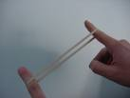
Potential or Kinetic?
A stretched rubber band.

Slide 5
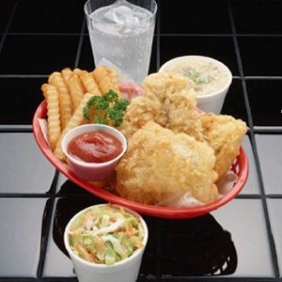
Gravitational, Elastic, or Chemical?
Our food and drink.

Slide 6
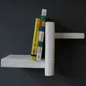
Gravitational, Elastic, or Chemical?
A book on a shelf.

Slide 7
Which one has more Kinetic energy?
If Ms. McGuirk rolled a bowling ball and a soccer ball down the aisle at the same speed, which one would have more kinetic energy?

Slide 8
Which one has more Kinetic Energy?
A tennis ball rolling slow or a tennis ball rolling fast?

Slide 9
Today’s Webquest
You are an energy engineer employed by Energy Quest Incorporated. You will encounter several links that are provided for research, quizzes, and online activities. Theses links will help develop an understanding of what potential and kinetic energy are and how they can be found in the world around you.
On Safari, get on to my Quia website
Following the instructions on your worksheet to read the websites, play the games, and answer the questions.
Make sure you follow your directions carefully!

