Slide 1
Catalyst (5 minutes)
Based on what we learned last week about predicting weather, in what kind of pressure area (high/low) do you think severe weather storms form?
What kinds of severe weather do you already know about?
Share an actual event of severe weather that you have heard about on the news or experienced yourself.

Slide 2
This Week
Monday, February 28th | Last 6th Grade Science Cornell Notes!
Tuesday, March 1st | Severe Weather Project: Day 1
Wednesday, March 2nd | Severe Weather Project: Day 2
Thursday, March 3rd | Severe Weather Project: Day 3
Friday, March 4th | Submitting Severe Weather Project/Island Friday
Over the weekend | Project Extra Credit Work on Island Friday Finalize Vocab Ring

Slide 3
Turn your book to Chapter 7 Section 3 page 198

Slide 4
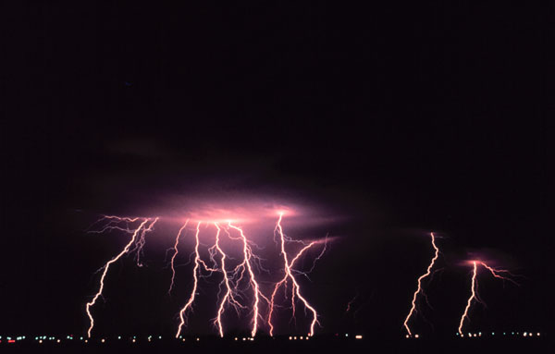
Thunderstorms
Small, intense weather systems that produce strong winds, heavy rain, lightning, and thunder.

Slide 5
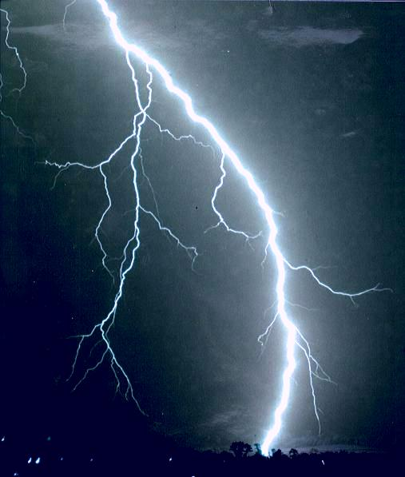
Lightning
An electric discharge that occurs between a positively charged area and a negatively charged area.
Lightning can happen between two clouds, between Earth and a cloud, or even between two parts of the same cloud.

Slide 6
Thunder
When lightning strikes, energy is released. This energy is transferred to the air and causes the air to expand rapidly and send out sound waves.
The sound that results from the rapid expansion of air along the lightning strike.
THUNDER IS THE RESULT OF AN ENERGY TRANSFORMATION!

Slide 7
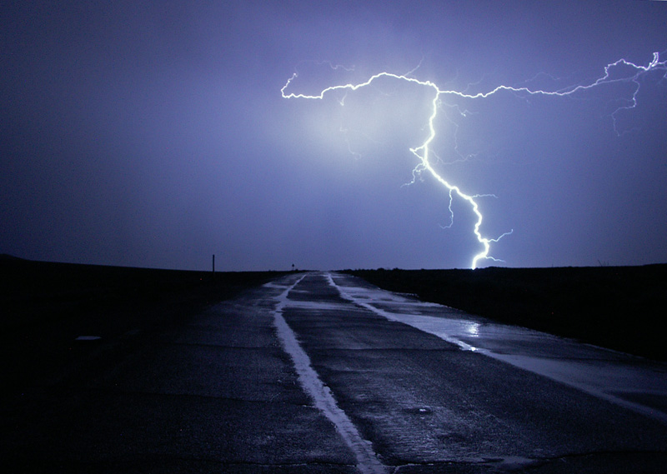
Severe Thunderstorms
Can cause high winds, hail, flash floods, and tornadoes.

Slide 8
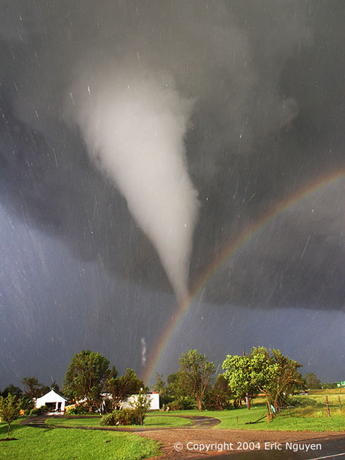
Tornadoes
A small, spinning column of air that has high wind speeds and low central pressure and that touches the ground.

Slide 9
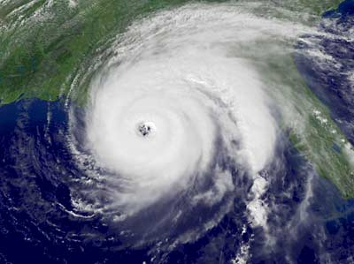
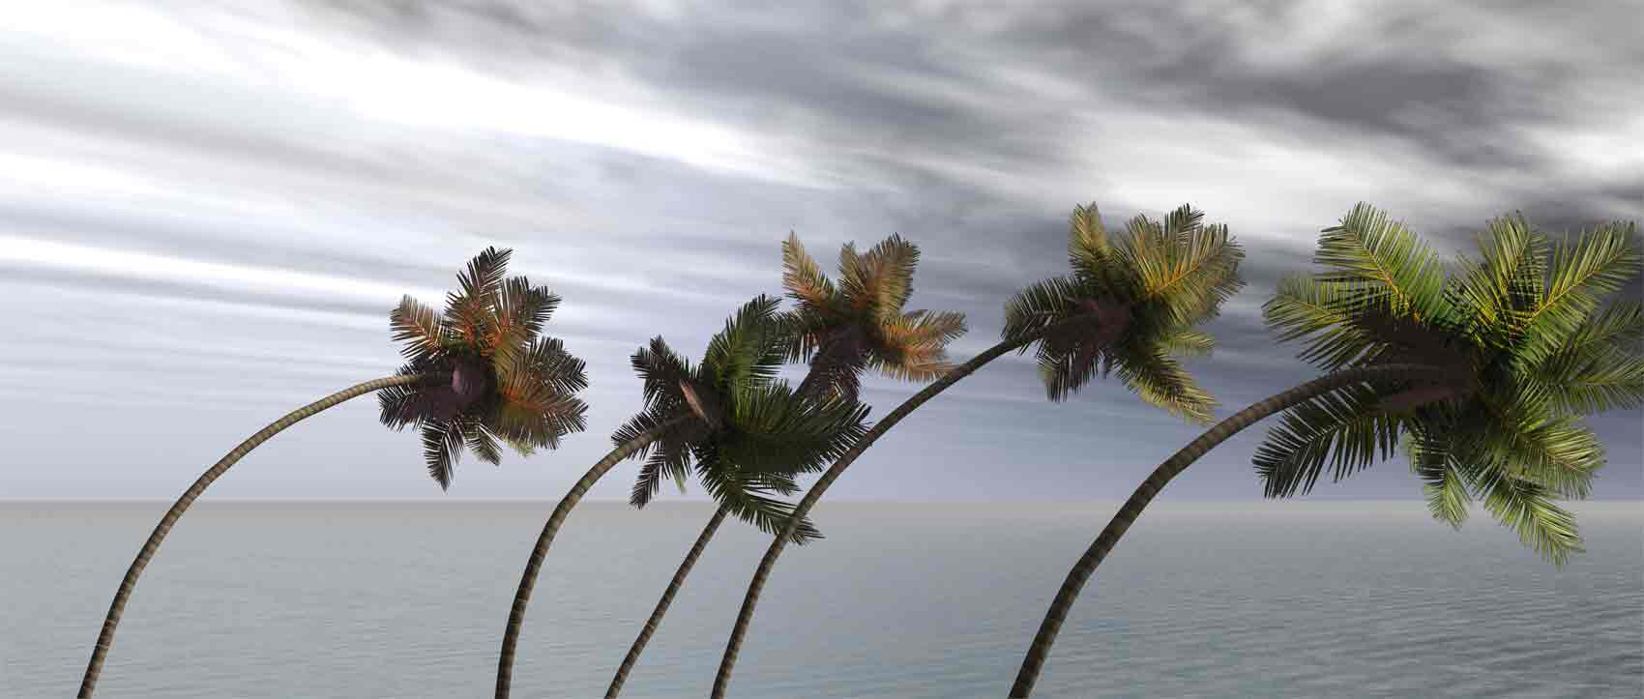
Hurricanes
Large rotating tropical weather system that has wind speeds of at least 120 km/hr (kilometers per hour)
Hurricanes that form in the western Pacific Ocean are called typhoons
Hurricanes that form over the Indian Ocean are called cyclones

Slide 10
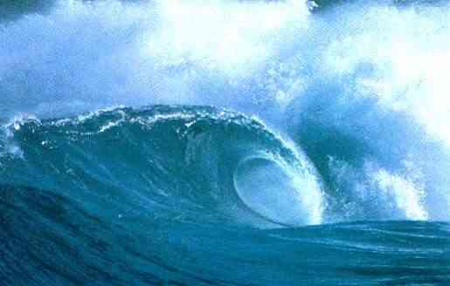
Tsunami (page 138)
Waves that form when a large volume of ocean water is suddenly moved up or down.
Can be caused by underwater earthquakes, volcanic eruptions, landslides, underwater explosions or the impact or a meteorite or comet.

Slide 11
Homework tonight
Tonight’s homework is a Word Search Puzzle with all of the terms that we learned about this week.
Make sure you are using your textbook (Chapter 7, Section 3 and page 138) in addition to your Cornell Notes from today to find all of your words.
WE WILL BE STARTING A PROJECT TOMORROW & THE ONLY HOMEWORK YOU WILL HAVE FOR THE REST OF THE WEEK WILL BE TO MAKE VOCAB NOTECARDS AND WORK ON YOUR PROJECT, so make sure you do tonight’s homework!

Slide 12
BRING YOUR COMPLETED ISLAND FRIDAY TRACKER TOMORROW! *I will be awarding the Study Island Scholars of February!!!

