Slide 1
Ocean Currents Group Activity
Group 5

Slide 2
“Message in a Bottle”
You are a stranded traveler that needs to send a message in a bottle for help.
What currents would your bottle travel as it left the west coast of the continent where Person 1 is located, and traveled to the east coast of Person 5?
Name the current(s)
Explain what direction they would travel (North, South, East, West)
Explain whether they would be cold or warm

Slide 3
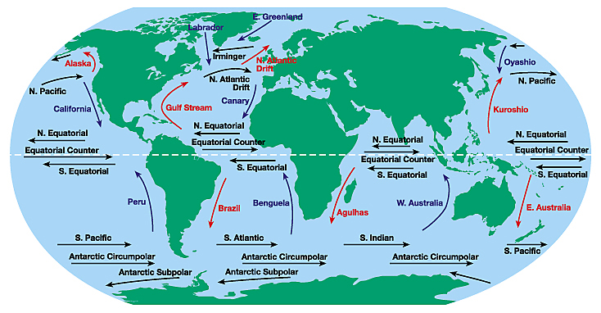
“Message in a Bottle”
5
2
1
4
6
3
7

Slide 4
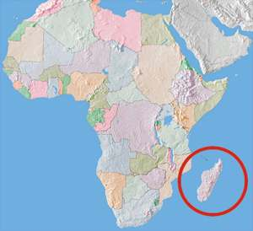
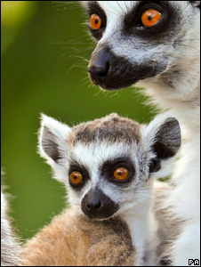
Animals depend on currents too!
Madagascar, the fourth largest island on the planet, is deemed one of the world's biological hotspots. Because of its isolation, most of its mammals, half its birds, and many of its plant species exist nowhere else on Earth.
The first mammals are believed to have appeared on the island about 60 million years ago, 100 million years after the landmass was thought to have separated from Africa. Scientists think that these animals could have floated on vegetation from the main continent of Africa. What current would have taken them there?

Slide 5
Currents affect Weather!
Open your textbooks to Chapter 5, Section 2 (page 130-133)
With your group, read the paragraph “Effects of El Nino”
Answer the following questions on your worksheet:
What disasters can occur as a result of El Nino?
What is a drought?
Where can these droughts occur?

Slide 6
The Global Conveyor Belt
Like Tim and Moby showed us in the Brain Pop video on, the deep current known as the “Global Conveyor Belt” is powered by temperature and density. Cold water sinks starting in the North Atlantic Ocean, and flows all the way down to the South Pole, then starts flowing north again. In
the Pacific, the water starts warming up, and returns to the surface. It flows back into the Atlantic Ocean, where it joins up, once again, with the Gulf Stream. And once the Gulf Stream waters reach the North Atlantic Ocean, they lose heat and sink, and the whole process starts all over again. The “Global Conveyor Belt” moves very slowly, it can take a thousand years to make a full circuit around the Earth.

Slide 7
Make sure your worksheet is complete, and prepare with your group to present your findings!

