Slide 1
Ocean Currents Group Activity
Group 1

Slide 2
“Message in a Bottle”
You are a stranded traveler that needs to send a message in a bottle for help.
What currents would your bottle travel as it left the east coast of the continent where Person 1 is located, and travel to the west coast of Person 2?
Name the current(s)
Explain what direction they would travel (North, South, East, West)
Explain whether they would be cold or warm

Slide 3
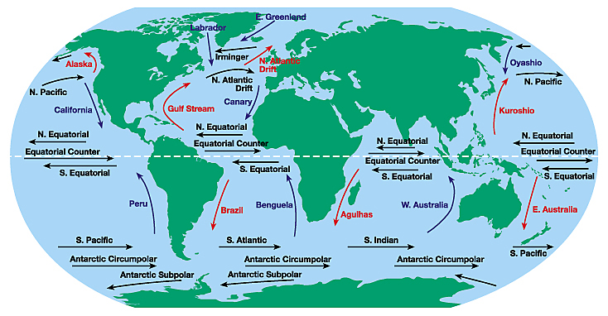
“Message in a Bottle”
5
2
1
4
6
3
7

Slide 4
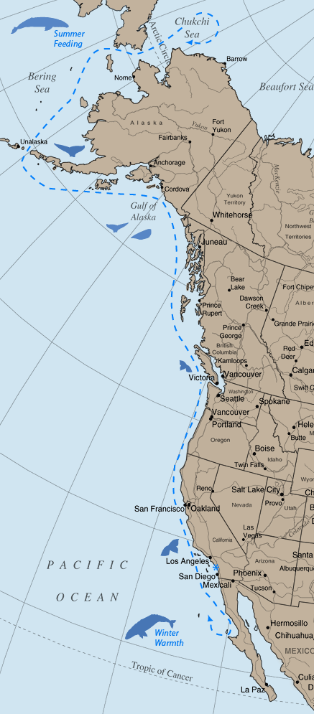
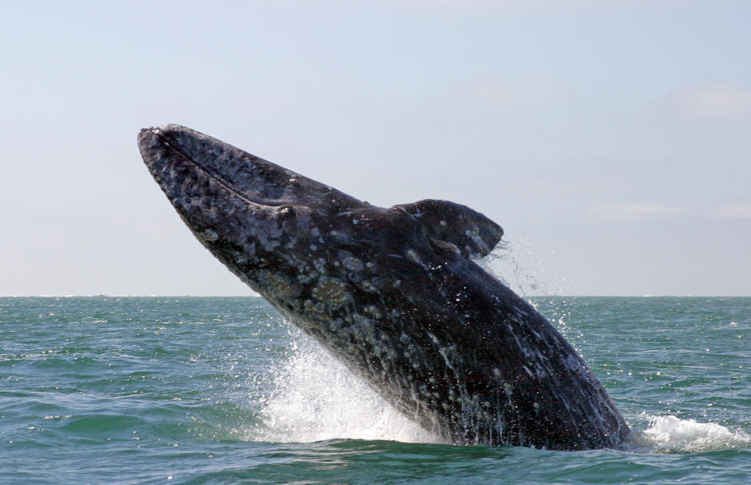
Animals depend on currents too!
The eastern Pacific stock of gray whales travels along the coast of the US and Mexico. During this annual migration, a gray whale can travel as far as 6,000 miles each way.
What current will a gray whale depend on as it travels south along the West Coast of the North America towards Mexico?

Slide 5
Currents affect Weather!
Open your textbooks to Chapter 5, Section 2 (page 130-133)
With your group, read “Warm-Water Currents and Climate”
Answer the following questions on your worksheet:
What do warm-water currents do to coastal areas?
How is the climate of the Scilly Isles very different from the climate of Newfoundland?
What is the warm-water current closest to our continent of North America?

Slide 6
The Global Conveyor Belt
Like Tim and Moby showed us in the Brain Pop video on, the deep current known as the “Global Conveyor Belt” is powered by temperature and density. Cold water sinks starting in the North Atlantic Ocean, and flows all the way down to the South Pole, then starts flowing north again. In
the Pacific, the water starts warming up, and returns to the surface. It flows back into the Atlantic Ocean, where it joins up, once again, with the Gulf Stream. And once the Gulf Stream waters reach the North Atlantic Ocean, they lose heat and sink, and the whole process starts all over again. The “Global Conveyor Belt” moves very slowly, it can take a thousand years to make a full circuit around the Earth.

Slide 7
Make sure your worksheet is complete, and prepare with your group to present your findings!

